Slide 1
雲端計算
Cloud Computing
Lab - EyeOS

Slide 2
Agenda
Installation
Programming

Slide 3
Installation
Download
Prepare Work
Start Install

Slide 4
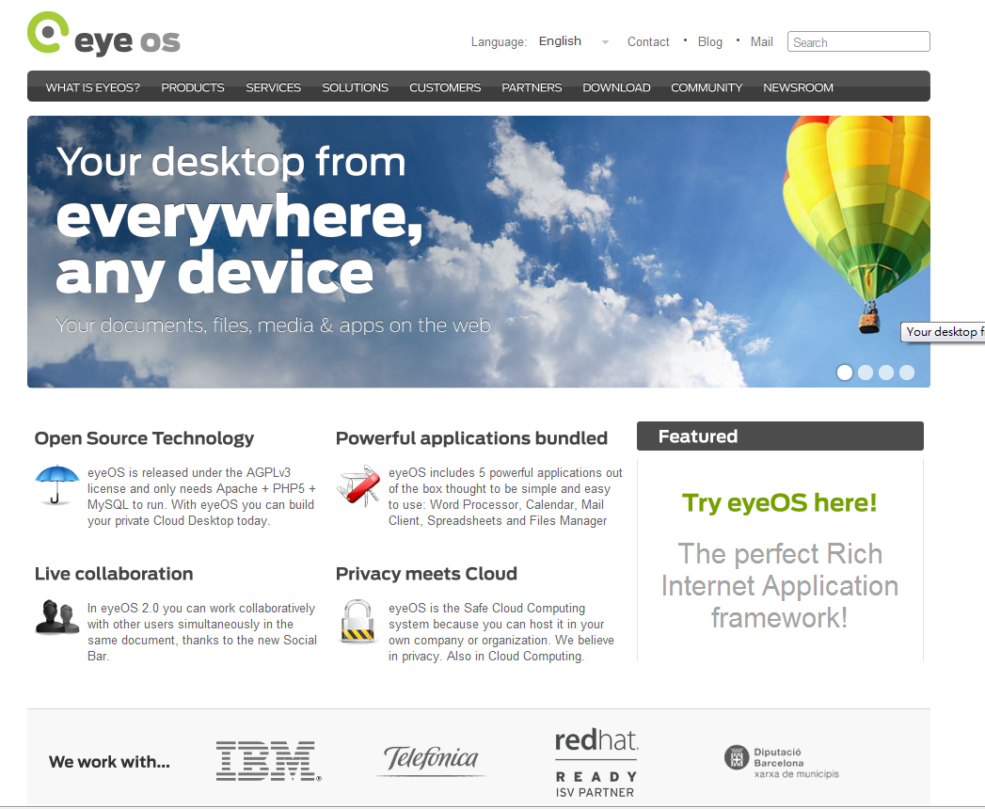
Download
http://www.eyeos.org/
http://eyeos.org/installation_manual.pdf
http://beta.my.eyeos.org/

Slide 5
Requirement
Requirements
  Apache HTTP Server 2.x
  MySQL-server and MySQL-client 5.x
  php 5.2, or higher

Slide 6
Test environment
LAMP
  Kubuntu 10.10 with kernel 2.6.35-22-generic
  Apache/2.2.16 (Ubuntu)
  MySQL 5.1.49-1ubuntu8 (Ubuntu)
  PHP 5.3.3-1ubuntu9

Slide 7
Installation
Download
Prepare Work
Start Install

Slide 8
MySQL
Logging in by root
  mysql –u root -p
Add a new database
  Create DATABASE eyeos
Add a new user for eyeOS
  GRANT ALL PRIVILEGES on eyeos.* TO eyeos IDENTIFIED by ‘PASSWORD’

Slide 9
And more
Extract the download file.
Move to root directory of Apache2
Change the privileges
  sudo chown –R www-data.www-data /var/www/eyeos

Slide 10
Installation
Download
Prepare Work
Start Install

Slide 11
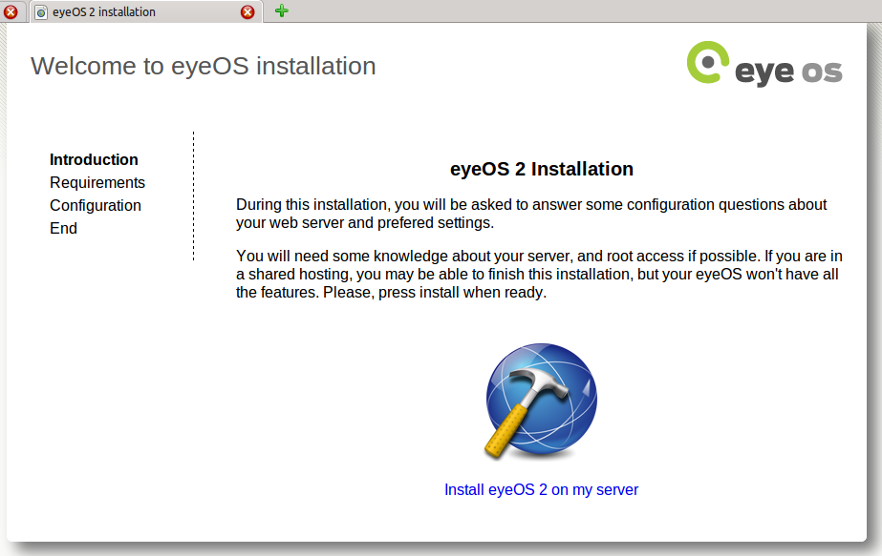
Step (1)
http://localhost/eyeos/install

Slide 12
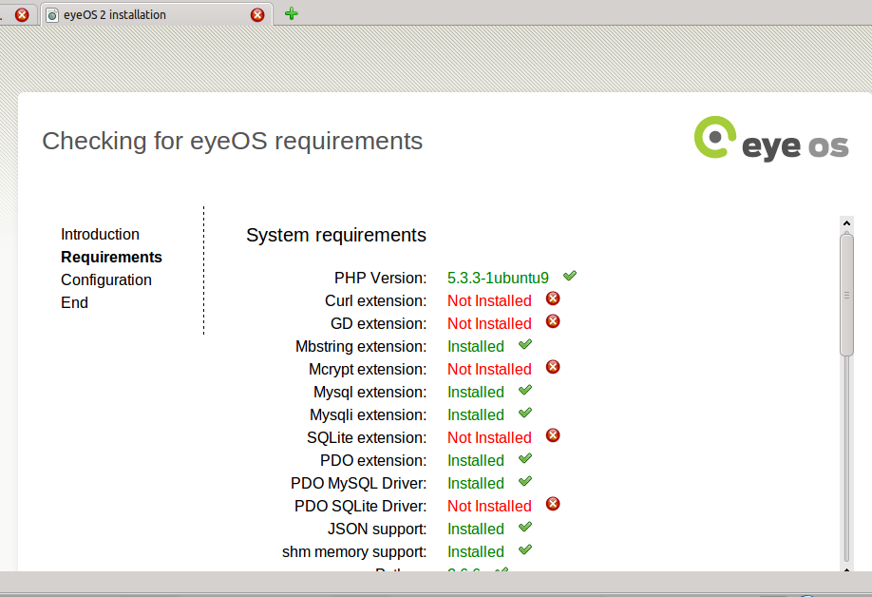
Step (2)
Recommand:
install all items

Slide 13
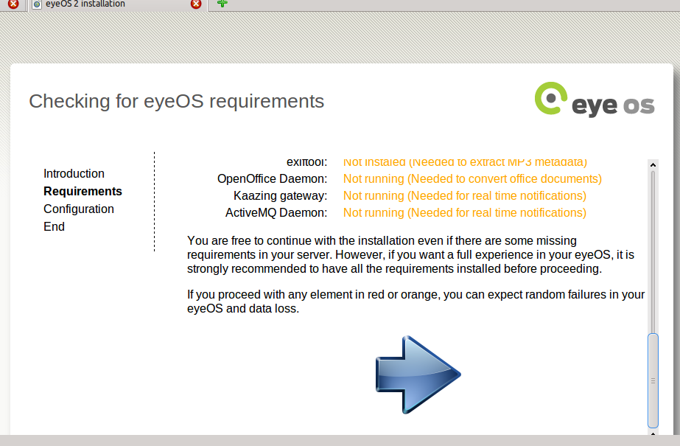
Step (3)

Slide 14
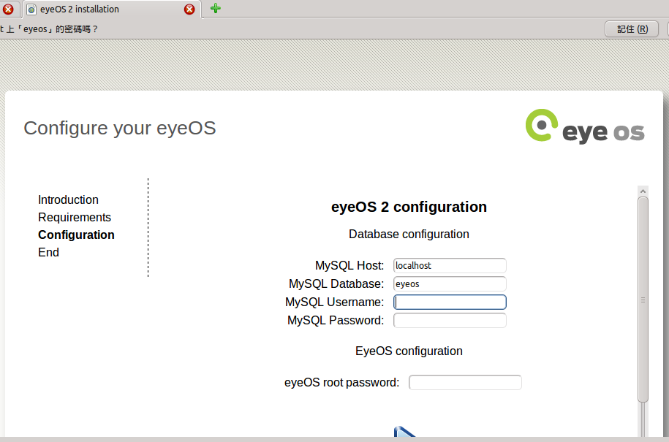
Step (4)
Username and password
you set before

Slide 15
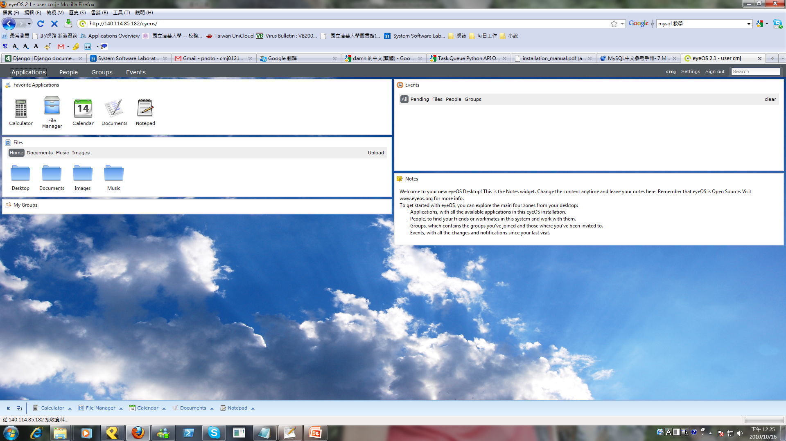
Result

Slide 16
Result

Slide 17
Programming

Slide 18
eyeOS 2.0
eyeOS 2.x is written by PHP, XML, and JavaScript.
PHP
  Major functionality for custom service.
  Background computation.
XML
  Service description.
JavaScript
  Web interface.
  Communication between user and server.
qooxdoo

Slide 19
Cases
Every service in eyeOS are applications.
  Application interface
  May not use any background resource.
Calculator
  Only XML and JavaScript.
  Computation on client.
Login
  Simplified of web skin.
  Connect to database.
  New user or authentication.

Slide 20


Model
eyeOS
<?PHP
fun1() {….}
fun1() {….}
fun1() {….}
?>
callback
Service.js
app.fun1(); app.fun1();
…
app.drawGUI();
XML
<meta>
….
</meta>

Slide 21
case
Calculator

Slide 22
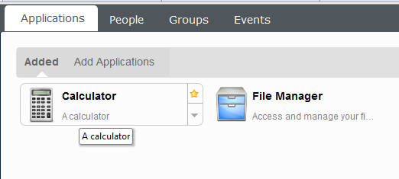
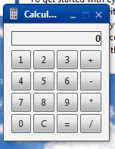
Result

Slide 23
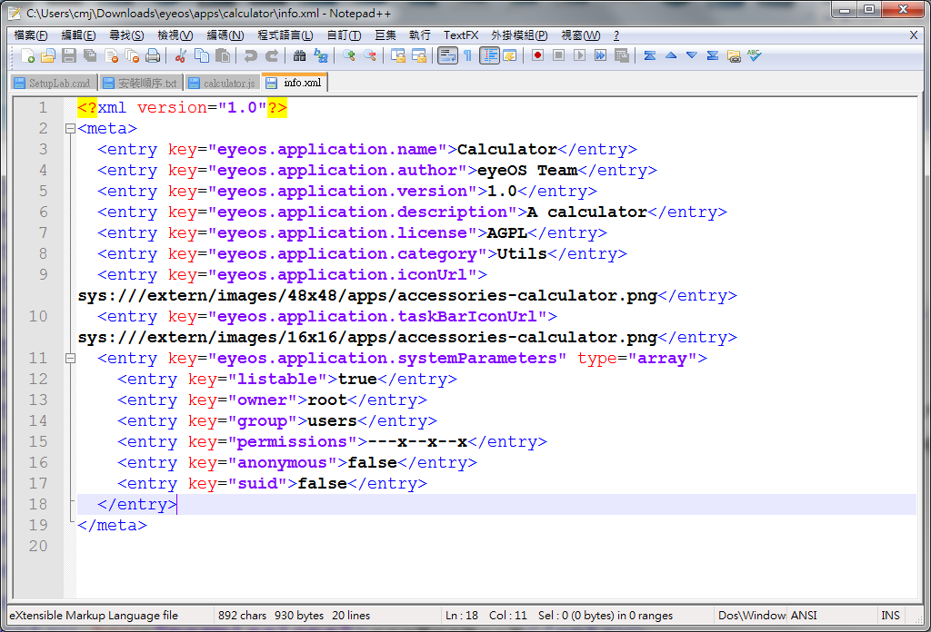
XML
Description
Setting

Slide 24
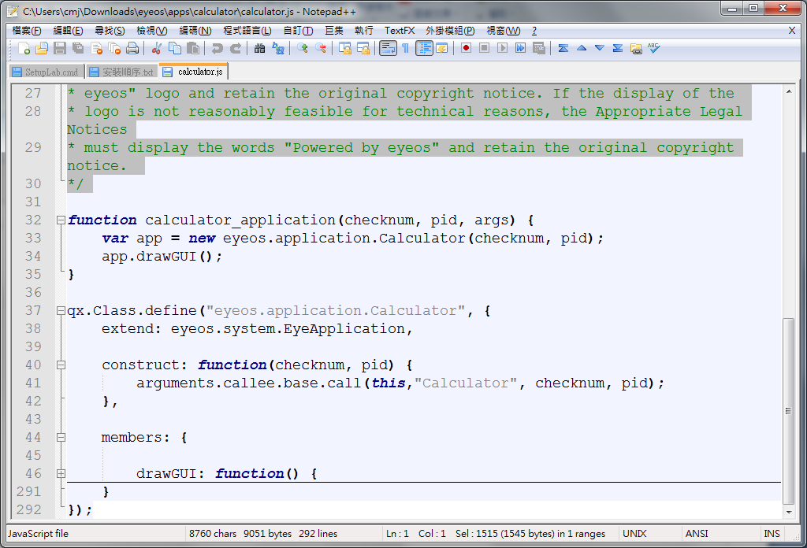
JavaScript
Main function
Definition

Slide 25
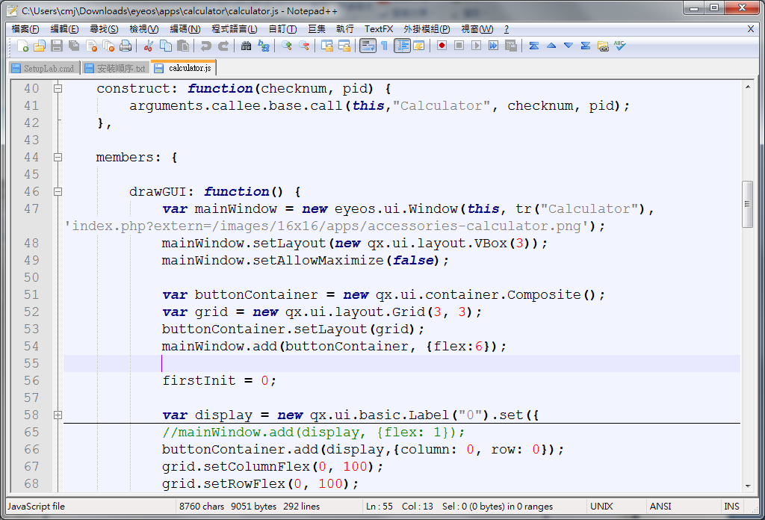
JavaScript (cont.)
Basic widget
Layout

Slide 26
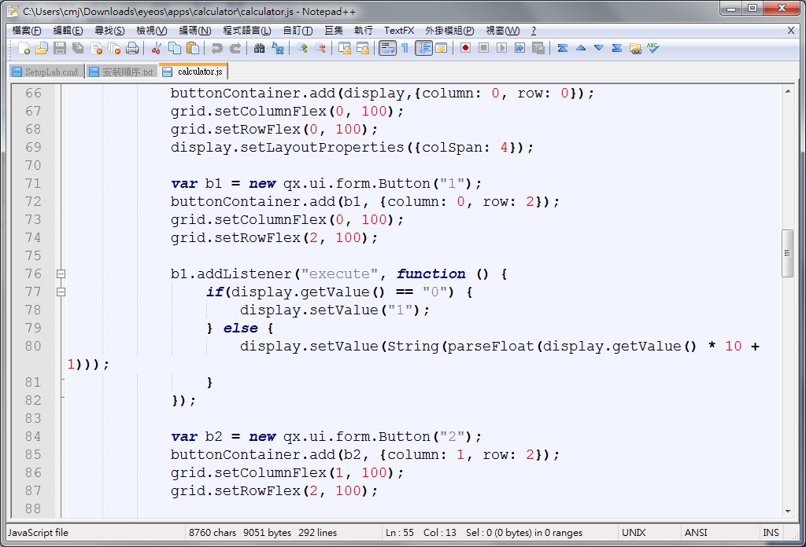
JavaScript (cont.)
Button
Execution

Slide 27
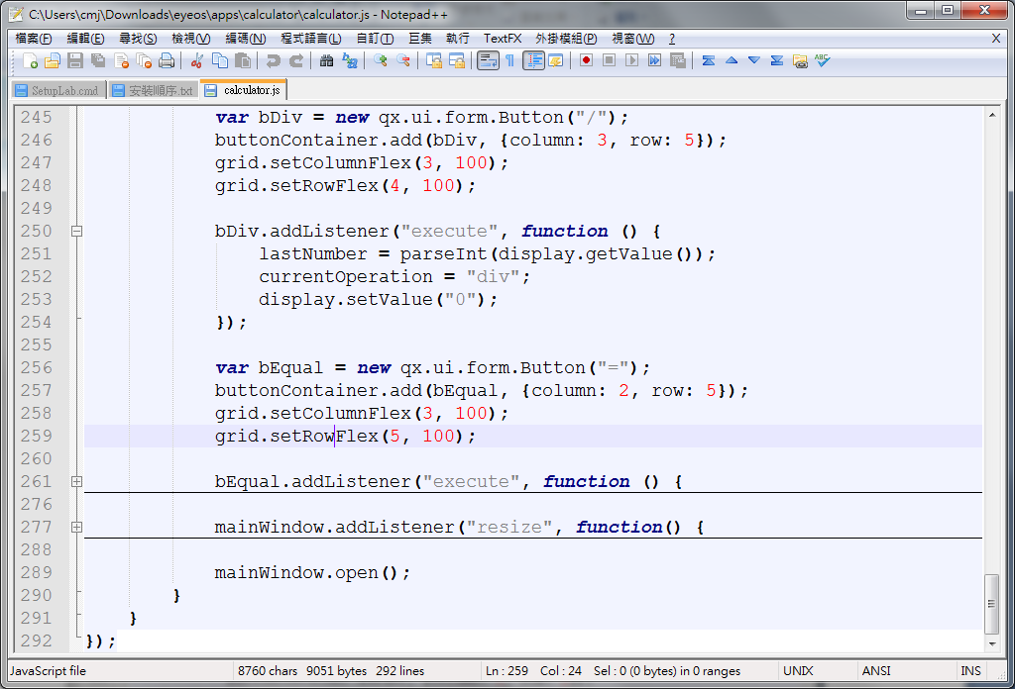
JavaScript (cont.)
Draw

Slide 28
case
Calculator
Login

Slide 29
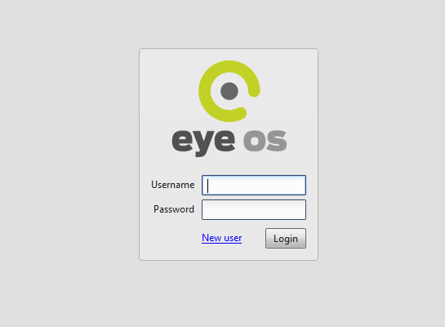
Result

Slide 30
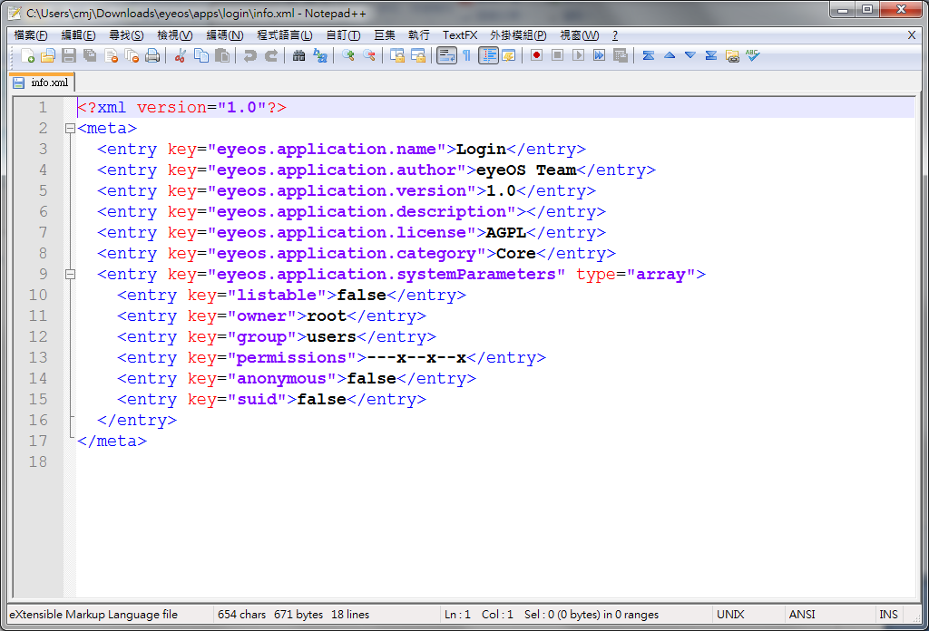
XML

Slide 31
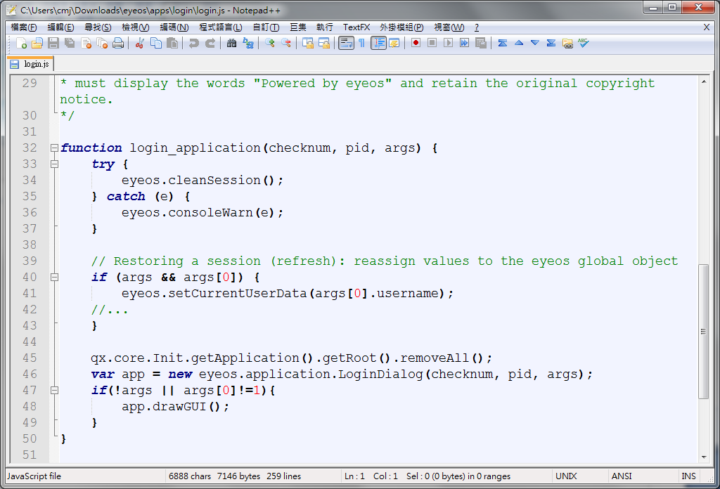
JavaScript

Slide 32
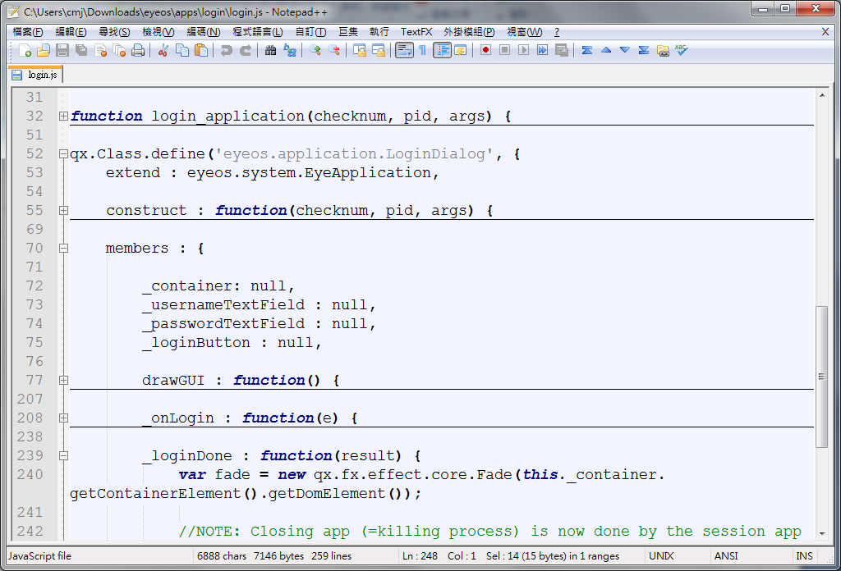
JavaScript (cont.)

Slide 33
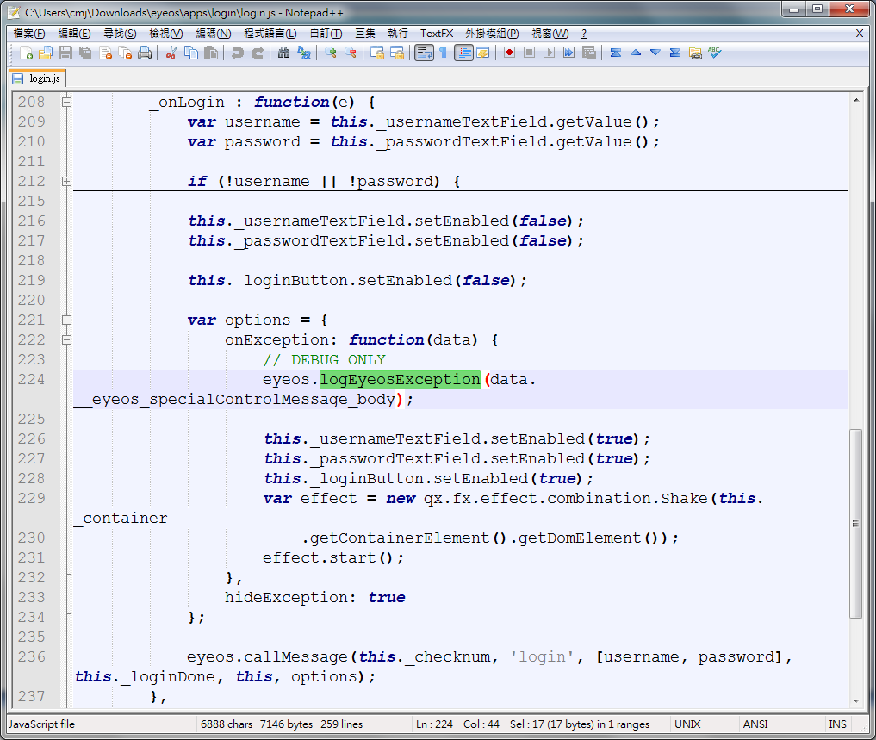
JavaScript (cont.)
Information
Parameter
Callback

Slide 34
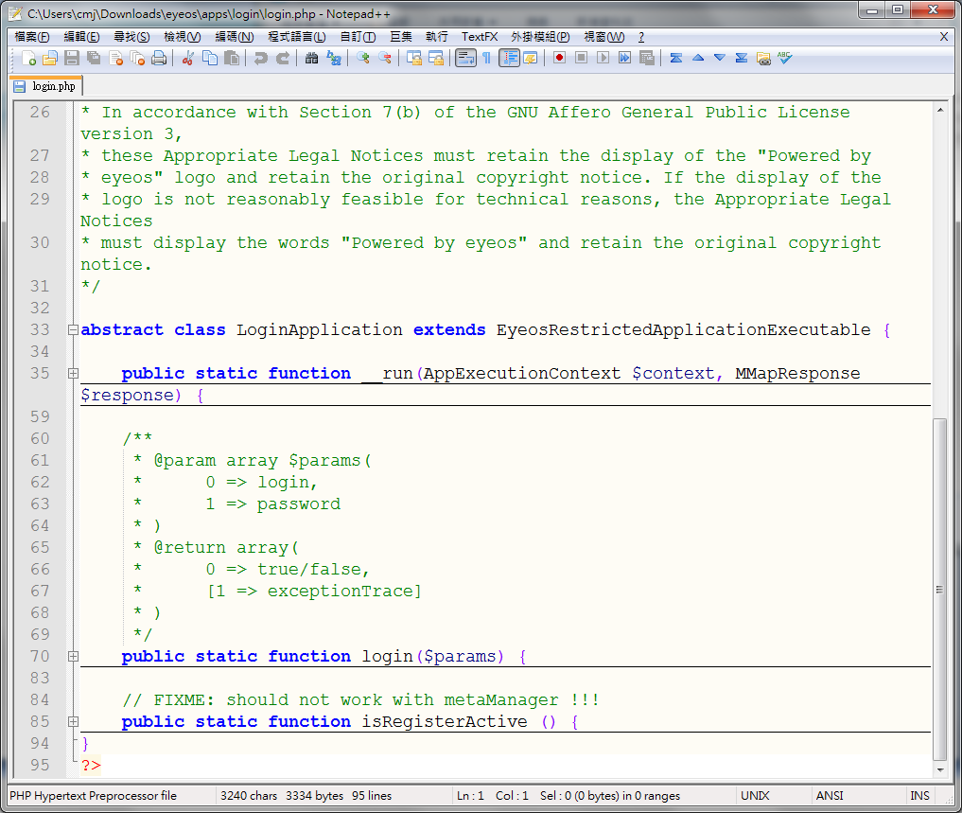
PHP
Initialization

Slide 35
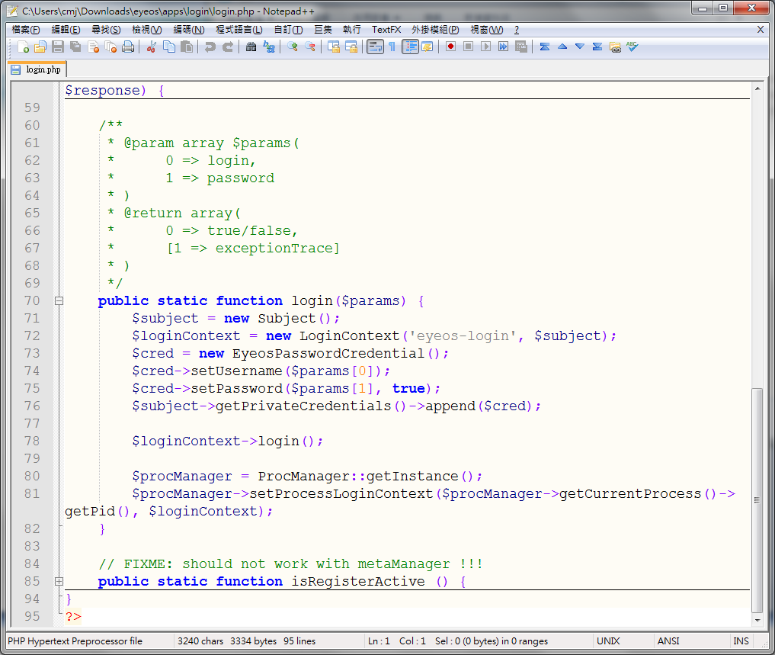
PHP (cont.)

Slide 36
case
Calculator
Login
Caution

Slide 37
JavaScript
calculator.js

Slide 38
JavaScript (cont.)

Slide 39
Callback

